Slide 1




#RintisKarirImpian
Portofolio - Intensive Bootcamp
Introduction to Problem Solving
Owner: (Mochammad Azriel Rizky Syahputra)
Build your skill and portfolio via myskill.id/bootcamp

Slide 2

Petunjuk Pengerjaan
Dokumen ini memang tidak open access untuk edit, maka silahkan copy file ini lalu kerjakanlah pada device masing-masing, dengan cara klik File pada pojok kiri atas, pilih Make a Copy. Setelah file berhasil di copy, ubah nama sesuai nama masing-masing. Untuk mengerjakan, perhatikan petunjuk dibawah ini:
Jawablah masing-masing pertanyaan di slide selanjutnya berdasarkan pengetahuanmu dan berdasarkan apa yang kamu pahami pada materi tiap sesi.
Set pengaturan akses file sebagai Publik namun cukup View Only agar tugas dapat dicek oleh Class Assistant.
Silahkan kirim link sheet mini task berikut di form pengumpulan mini task yang sudah tersedia di To Do List bootcamp Data Analysis batch 19.
Upload pekerjaanmu di LinkedIn dan tag @MySkill juga Class Assistant yang mendampingi serta Tutor yang mengajar di sesi kelas. Yang di upload boleh berupa file PPT, maupun screenshot dari file ini.
#RintisKarirImpian

Slide 3
Mini Task
Halojek is a company with 2 main product:
Halofood : a service to provide food delivery
Haloride : a service to provide mobility using motor cycles
The revenue on this quarter (Q3, 23) is decreased for 50% compared to same quarter last year (Q3, 22)

Slide 4
Mini Task (Cont)
The cost for this quarter is as follow:
Marketing cost : IDR 800 Bio,
Labor cost: IDR 750 Bio
Infrastructure cost: IDR 3,500 Bio
The cost for last quarter is as follow:
Marketing cost : IDR 600 Bio,
Labor cost: IDR 600 Bio
Infrastructure cost: IDR 2000 Bio
Objective: Develop problem solving framework for the case above, you are a data analyst to deep dive the root cause of cost increasing on this quarter and also provide the alternative

Slide 5
Step 1: Clarify the Problem
Clue: Quantified the gap
Ideal Condition:
Revenue in Q3 2023 should match or exceed Q3 2022, with costs maintained at Q2 2023 levels of IDR 3,200 billion (Marketing: IDR 600 billion, Labor: IDR 600 billion, Infrastructure: IDR 2,000 billion).
Gap:
Revenue declined 50%, and costs increased by IDR 1,850 billion (Marketing, Labor, Infrastructure).
Existing Condition:
Revenue in Q3 2023 dropped 50% from Q3 2022, while costs increased to IDR 5,050 billion (Marketing: IDR 800 billion, Labor: IDR 750 billion, Infrastructure: IDR 3,500 billion).
#RintisKarirImpian

Slide 6
Step 2: Breakdown the Problem
Clue: Should be data driven | 4W - What, Where, Who, When
Ideal Condition:
Revenue in Q3 2023 should match or exceed Q3 2022, with costs maintained at Q2 2023 levels of IDR 3,200 billion (Marketing: IDR 600 billion, Labor: IDR 600 billion, Infrastructure: IDR 2,000 billion).
Haloride
IDR 740 billion
Gap:
IDR 1,850 billion
Marketing
IDR 111 billion
Existing Condition:
Revenue in Q3 2023 dropped 50% from Q3 2022, while costs increased to IDR 5,050 billion (Marketing: IDR 800 billion, Labor: IDR 750 billion, Infrastructure: IDR 3,500 billion).
Halofood
IDR 1,110 billion
Labor
IDR 166.5 billion
Infrastructure
IDR 832.5 billion
#RintisKarirImpian

Slide 7
Step 3: Set the Objective
Clue: objective should be quantified and time-bound
Haloride
IDR 740 billion
Halojek allocates additional budget for Halofood, especially in the infrastructure segment, with the hope of overcoming a 50% decline in revenue in Q3 2023.
Ideal Condition:
Revenue in Q3 2023 should match or exceed Q3 2022, with costs maintained at Q2 2023 levels of IDR 3,200 billion (Marketing: IDR 600 billion, Labor: IDR 600 billion, Infrastructure: IDR 2,000 billion).
Marketing
IDR 111 billion
Gap:
IDR 1,850 billion
Labor
IDR 166.5 billion
Existing Condition:
Revenue in Q3 2023 dropped 50% from Q3 2022, while costs increased to IDR 5,050 billion (Marketing: IDR 800 billion, Labor: IDR 750 billion, Infrastructure: IDR 3,500 billion).
Halofood
IDR 1,110 billion
Infrastructure
IDR 832.5 billion
Develop concrete target with 2 core component :
how mucah and when?
#RintisKarirImpian

Slide 8
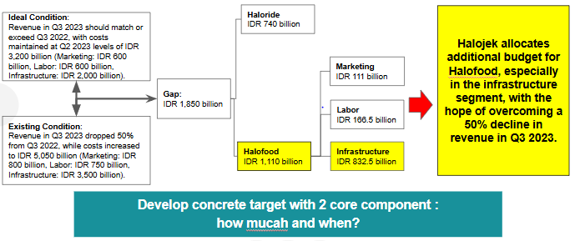
Step 4: Define the root cause
Clue:
Why, why, why
Brainstorm is allowed
Focusing on Why
Deepdive could use or 5M(Man,Machine,Material,Method,Market,Money)
Money
why halojek allocates additional funds for halofood products,
especially in the infrastructure segment in Q3 2023?
Has the budget allocation for infrastructure been used well?
Man
Machine
Material
Market
Is there a labor shortage?
is there a problem or damage to the motorcycle?
Does every driver have a Halojek jacket?
Is the extra infrastructure funding misaligned with market preferences?
#RintisKarirImpian

Slide 9
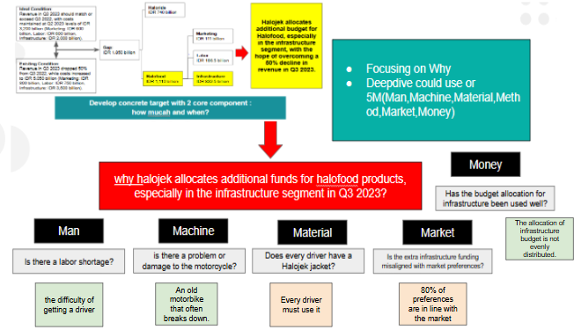
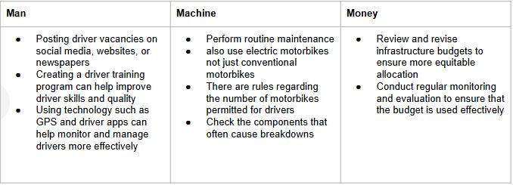
5. Develop Countermeasures
#RintisKarirImpian

Slide 10
Terima Kasih
Mochammad Azriel Rizky Syahputra
Data Analyst Batch 20
#RintisKarirImpian

